Slide 1
#Major
#Computer Engenering
Example Lora and Development direction
PRESENTATION
#Number
#20141385
#Name
서현식
#IT-Hanbat

Slide 2
Example Lora and Development direction
Introduce
What is Lora
Example
A real-life example of Lora
Development direction
How much is Lora worth
Q&A

Slide 3
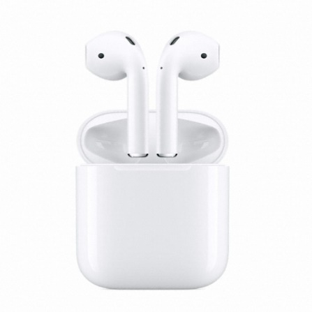
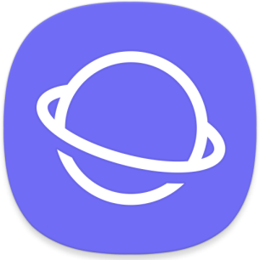
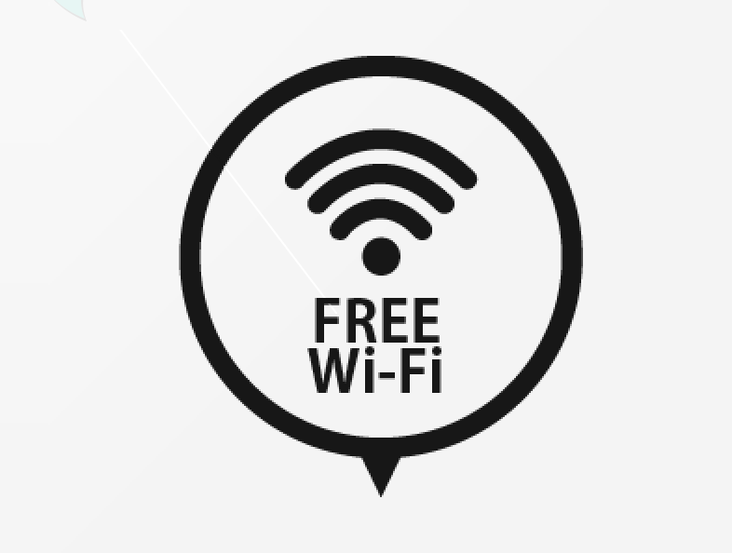
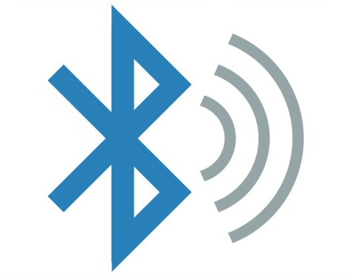
What is Lora
#BlueTooth
#Close
#WiFi
#Free
#Object
#Internet

Slide 4
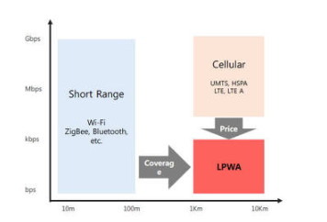
What is Lora
#Wi-Fi
#BlueTooth
#LowPower
#Wolrd-wide
#network
#Lora
#smart-IOT
#challenge

Slide 5
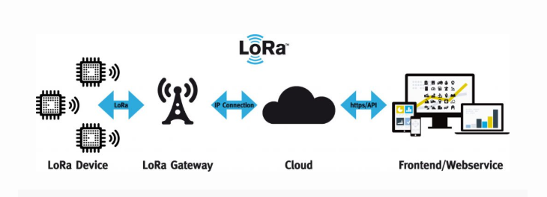
What is Lora
CONTENTS A
아래 살짝 보이는 아이콘을 클릭해 보세요
#Click
#Explain
#Principle
#Image
#User
#utillizes
#network
#low battery
#Data

Slide 6


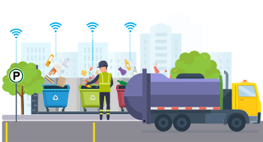
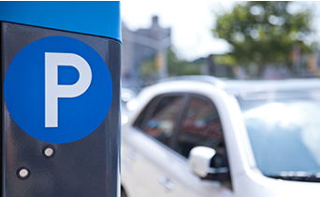
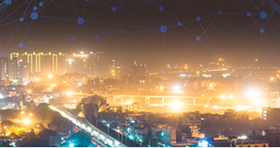
The user Of Lora
#implement
#sensor
#Research
#sensor
#real-time
#TMI
#Simple

Slide 7
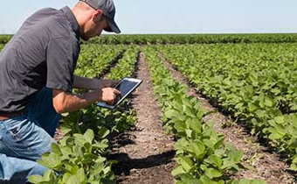

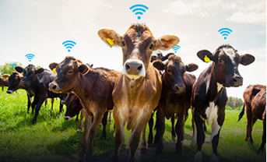
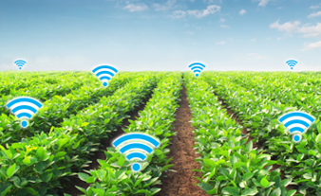
The user Of Lora
#Tag
#User
#Smart
#Temperature
#Send

Slide 8
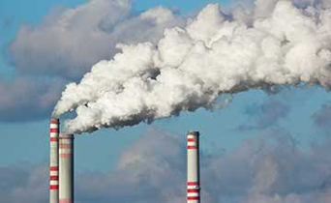

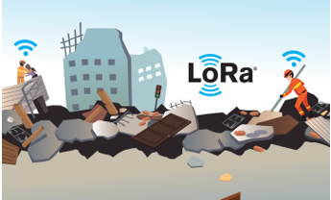
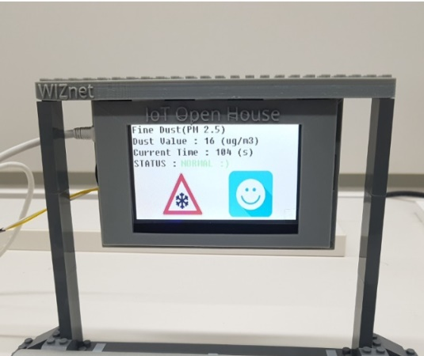

The user Of Lora
#disater
#Bluetooth
#dust
#how much
#flood
#send

Slide 9
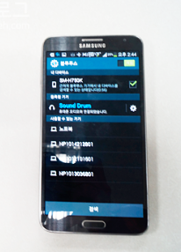
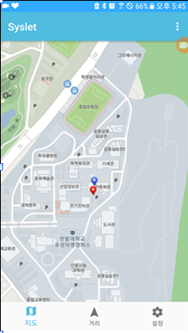
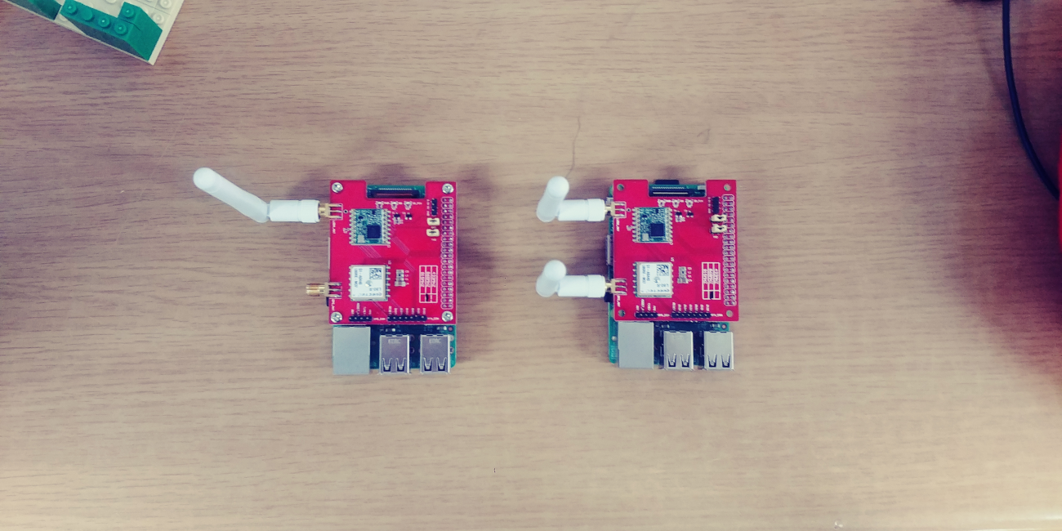
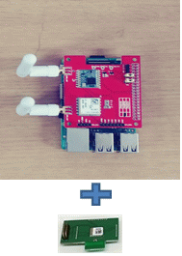


The user Of Lora
위도
경도
#UV
#Hanbat
#TMI
#BlueTooth
#Image
#RPI

Slide 10
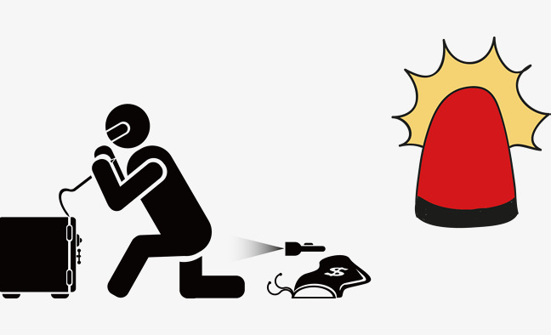
The user Of Lora
Safe zone
#safe
#TMI
#BlueTooth
#Image
#RPI

Slide 11

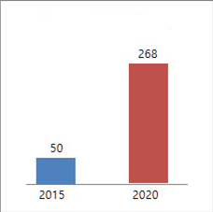
Development direction
Development direction
IOT Market Size
IMG
World $300 billion
World $ 1.2
trillion
Korea
13.7 trillion won
IOT MarketSize
World Product sales : $300 billon
World value added : $1.2 trillion
Korea Market size : 13.7 trillion won
product sales
Value added
Market size
IMG
Number of IOT
Number of IOT
2015 : 50 billion
2020 : 268 billon

Slide 12
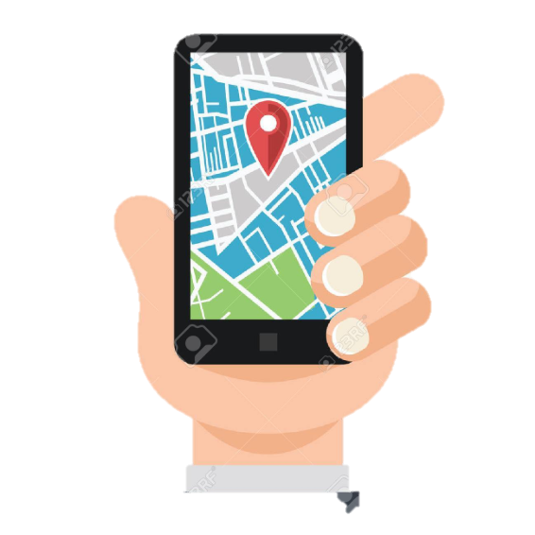

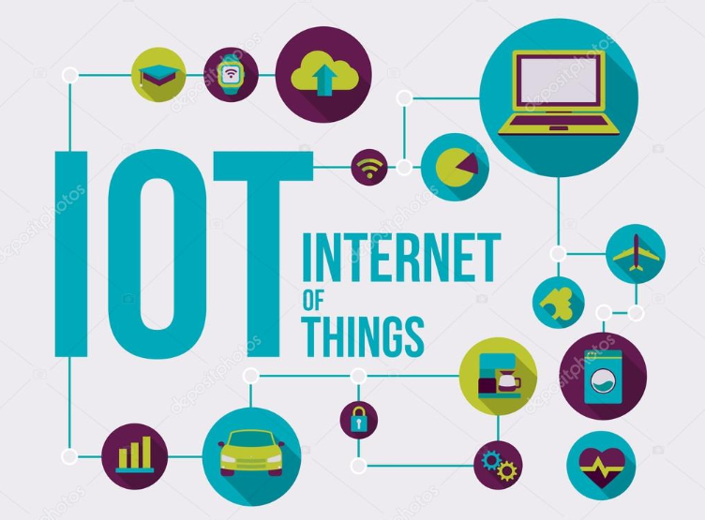
Development direction
#Applied
#APP
#TMI
#IOT
#GPS
#Simple

Slide 13
Q&A

